Slide 1
Backtracking
Lecture 8

Slide 2
Backtracking
Suppose you have to make a series of decisions, among various choices, where
  You don’t have enough information to know what to choose
  Each decision leads to a new set of choices
  Some sequence of choices (possibly more than one) may be a solution to your problem
Backtracking is a methodical way of trying out various sequences of decisions, until you find one that “works”

Slide 3
Introduction
Backtracking is used to solve problems in which a sequence of objects is chosen from a specified set so that the sequence satisfies some criterion.
Backtracking is a modified depth-first search of a tree.
Backtracking involves only a tree search.
Backtracking is the procedure whereby, after determining that a node can lead to nothing but dead nodes, we go back (“backtrack”) to the node’s parent and proceed with the search on the next child.

Slide 4
Introduction …
We call a node nonpromising if when visiting the node we determine that it cannot possibly lead to a solution. Otherwise, we call it promising.
In summary, backtracking consists of
  Doing a depth-first search of a state space tree,
  Checking whether each node is promising, and, if it is nonpromising, backtracking to the node’s parent.
This is called pruning the state space tree, and the subtree consisting of the visited nodes is called the pruned state space tree.

Slide 5
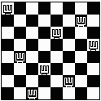
Backtracking – 8 Queens Problem
Find an arrangement of 8 queens on a single chess board such that no two queens are attacking one another.
In chess, queens can move all the way down any row, column or diagonal (so long as no pieces are in the way).
  Due to the first two restrictions, it's clear that each row and column of the board will have exactly one queen.
This is also called the N Queens problem since we can solve this problem for any NxN board with N Queens as well.

Slide 6

Backtracking – 8 Queens Problem
The backtracking strategy is as follows:
  Place a queen on the first available square in row 1.
  Move onto the next row, placing a queen on the first available square there (that doesn't conflict with the previously placed queens).
  Continue in this fashion until either:
    you have solved the problem, or
    you get stuck.
      When you get stuck, remove the queens that got you there, until you get to a row where there is another valid square to try.
Q
Q
Q
Q
Q
Q
Continue…

Slide 7
Backtracking – Eight Queens Problem
When we carry out backtracking, an easy way to visualize what is going on is a tree that shows all the different possibilities that have been tried.
On the board we will show a visual representation of solving the 4 Queens problem (placing 4 queens on a 4x4 board where no two attack one another).

Slide 8

Backtracking in Decision Trees
empty board
Q
place 1st queen
Q
Q
Q
place 2nd queen
Q
Q
Q
Q
Q
Q
place 3rd queen
Q
Q
Q
Q
Q
place 4th queen
Q
Q
Q

Slide 9
Backtracking – Eight Queens Problem
The neat thing about coding up backtracking, is that it can be done recursively, without having to do all the bookkeeping at once.
  Instead, the stack or recursive calls do most of the bookkeeping
  (ie, keeping track of which queens we've placed, and which combinations we've tried so far, etc.)

Slide 10
perm[] - stores a valid permutation of queens from index 0 to location-1.
location – the row we are placing the next queen
usedList[] – keeps track of the columns in which the queens have already been placed.
void solveItRec(int perm[], int location, struct onesquare usedList[]) {
if (location == SIZE) {
printSol(perm);
}
for (int i=0; i<SIZE; i++) {
if (usedList[i] == false) {
if (!conflict(perm, location, i)) {
perm[location] = i;
usedList[i] = true;
solveItRec(perm, location+1, usedList);
usedList[i] = false;
}
}
}
}
Found a solution to the problem, so print it!
Loop through possible columns to place this queen.
Only try this column if it hasn’t been used
Check if this position conflicts with any previous queens on the diagonal
mark the queen in this column
mark the column as used
solve the next row location recursively
un-mark the column as used, so we can get ALL possible valid solutions.

Slide 11
Backtracking – 8 Queens Problem
Animated Example:
http://www.hbmeyer.de/backtrack/achtdamen/eight.htm#up

Slide 12
Example Problem
  Show the first 2 solutions to the 5 queens problem that this algorithm would create.
    Also show the decision tree as shown in class.

Slide 13

Example Problem
Finish the 5 Queens solution from this point, how many times do you have to backtrack?
Q

Slide 14
Backtracking – 8 queens problem - Analysis
Another possible brute-force algorithm is generate the permutations of the numbers 1 through 8 (of which there are 8! = 40,320),
  and uses the elements of each permutation as indices to place a queen on each row.
  Then it rejects those boards with diagonal attacking positions.
The backtracking algorithm, is a slight improvement on the permutation method,
  constructs the search tree by considering one row of the board at a time, eliminating most non-solution board positions at a very early stage in their construction.
  Because it rejects row and diagonal attacks even on incomplete boards, it examines only 15,720 possible queen placements.

Slide 15
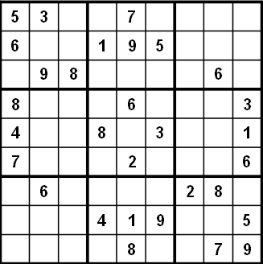
Another Example- Sudoku
9 by 9 matrix with some numbers filled in
all numbers must be between 1 and 9
Goal: Each row, each column, and each mini matrix must contain the numbers between 1 and 9 once each
  no duplicates in rows, columns, or mini matrices

Slide 16
Solving Sudoku – Brute Force
A brute force algorithm is a simple but general approach
Try all combinations until you find one that works
This approach isn’t clever, but computers are fast
Then try and improve on the brute force resuts

Slide 17
Solving Sudoku
Brute force Sudoku Soluton
  if not open cells, solved
  scan cells from left to right, top to bottom for first open cell
  When an open cell is found start cycling through digits 1 to 9.
  When a digit is placed check that the set up is legal
  now solve the board
1

Slide 18
Solving Sudoku – Later Steps
1
1
2
1
2
4
1
2
4
8
1
2
4
8
9
uh oh!

Slide 19
Sudoku – A Dead End
We have reached a dead end in our search
With the current set up none of the nine digits work in the top right corner
1
2
4
8
9

Slide 20
Backing Up
1
2
4
8
9
When the search reaches a dead end in backs up to the previous cell it was trying to fill and goes onto to the next digit
We would back up to the cell with a 9 and that turns out to be a dead end as well so we back up again
  so the algorithm needs to remember what digit to try next
Now in the cell with the 8. We try and 9 and move forward again.
1
2
4
9

Slide 21
Characteristics of Brute Force and Backtracking
Brute force algorithms are slow
The don't employ a lot of logic
  For example we know a 6 can't go in the last 3 columns of the first row, but the brute force algorithm will plow ahead any way
But, brute force algorithms are fairly easy to implement as a first pass solution
  backtracking is a form of a brute force algorithm

Slide 22
Key Insights
After trying placing a digit in a cell we want to solve the new sudoku board
  Isn't that a smaller (or simpler version) of the same problem we started with?!?!?!?
After placing a number in a cell the we need to remember the next number to try in case things don't work out.
We need to know if things worked out (found a solution) or they didn't, and if they didn't try the next number
If we try all numbers and none of them work in our cell we need to report back that things didn't work

Slide 23
Problems such as Suduko can be solved using
recursive because later versions of the problem are just slightly simpler versions of the original
backtracking because we may have to try different alternatives

Slide 24
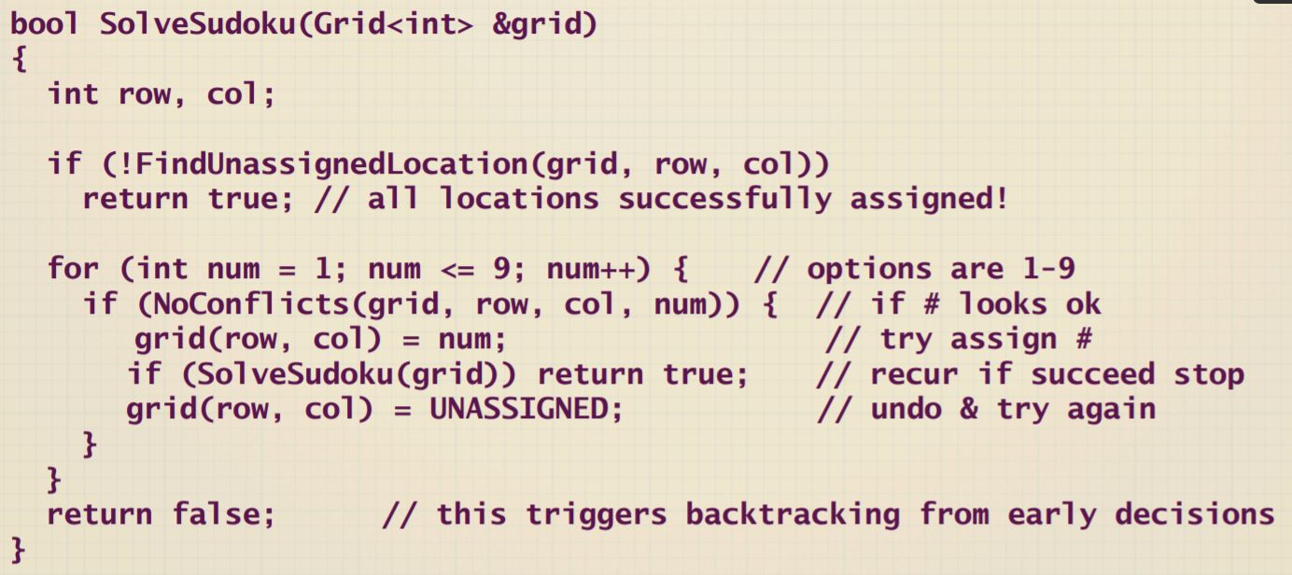
Pseudo code

Slide 25
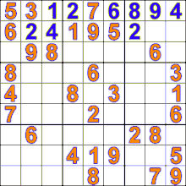
Sudoku Backtracking Animation

Slide 26
Goals of Backtracking
Possible goals
  Find a path to success
  Find all paths to success
  Find the best path to success
Not all problems are exactly alike, and finding one success node may not be the end of the search
Start
Success!
Success!

Slide 27
Mazes and Backtracking
An example of something that can be solved using backtracking is a maze.
  From your start point, you will iterate through each possible starting move.
  From there, you recursively move forward.
  If you ever get stuck, the recursion takes you back to where you were, and you try the next possible move.
In dealing with a maze, to make sure you don't try too many possibilities,
  one should mark which locations in the maze have been visited already so that no location in the maze gets visited twice.
  (If a place has already been visited, there is no point in trying to reach the end of the maze from there again.

Slide 28
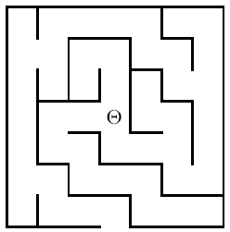
Another Backtracking Problem
A Simple Maze
Search maze until way
out is found. If no way
out possible report that.

Slide 29
The Local View
Which way do
I go to get
out?
North
West
East
Behind me, to the South
is a door leading South

Slide 30
Modified Backtracking Algorithm for Maze
If the current square is outside, return TRUE to indicate that a solution has been found.
If the current square is marked, return FALSE to indicate that this path has been tried.
Mark the current square.
for (each of the four compass directions)
{ if ( this direction is not blocked by a wall )
{ Move one step in the indicated direction from the current square.
Try to solve the maze from there by making a recursive call.
If this call shows the maze to be solvable, return TRUE to indicate that fact.
}
}
Unmark the current square.
Return FALSE to indicate that none of the four directions led to a solution.

Slide 31
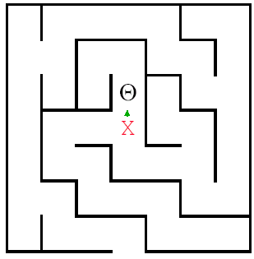
Backtracking in Action
The crucial part of the
algorithm is the for loop
that takes us through the
alternatives from the current
square. Here we have moved
to the North.
for (dir = North; dir <= West; dir++)
{ if (!WallExists(pt, dir))
{if (SolveMaze(AdjacentPoint(pt, dir)))
return(TRUE);
}

Slide 32
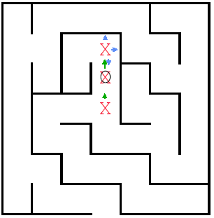
Backtracking in Action
Here we have moved
North again, but there is
a wall to the North .
East is also
blocked, so we try South.
That call discovers that
the square is marked, so
it just returns.

Slide 33
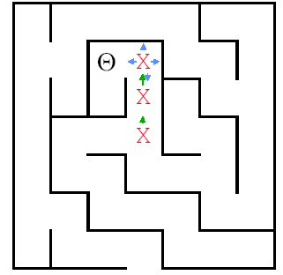
So the next move we
can make is West.
Where is this leading?

Slide 34
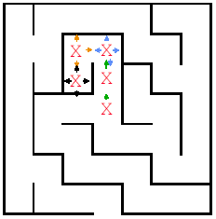
This path reaches
a dead end.
Time to backtrack!
Remember the
program stack!

Slide 35
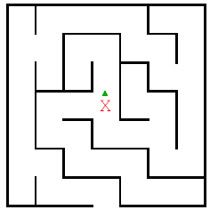
The recursive calls
end and return until
we find
ourselves back here.

Slide 36
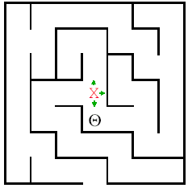
And now we try
South

Slide 37
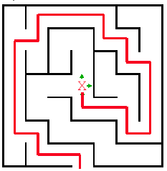
Path Eventually Found

Slide 38
Visualization and code
https://trinket.io/python/6ec2ecb76b

Slide 39
Graph Coloring Problem
Let G be undirected graph and let c be an integer.
Assignment of colors to the vertices or edges such that no two adjacent vertices are to be similarly colored.
We want to minimize the number of colors used.
The smallest c such that a c-coloring exists is called the graph’s chromatic number and any such c-coloring is an optimal coloring.

Slide 40
Coloring of Graph
The graph coloring optimization problem: find the minimum number of colors needed to color a graph.
The graph coloring decision problem: determine if there exists a coloring for a given graph which uses at most m colors.
Two colors
No solution with two colors

Slide 41
Coloring of Graphs
Practical applications: scheduling, time-tabling, register allocation for compilers, coloring of maps.
A simple graph coloring algorithm - choose a color and an arbitrary starting vertex and color all the vertices that can be colored with that color.
Choose next starting vertex and next color and repeat the coloring until all the vertices are colored.
Four colors
Three colors are enough

Slide 42
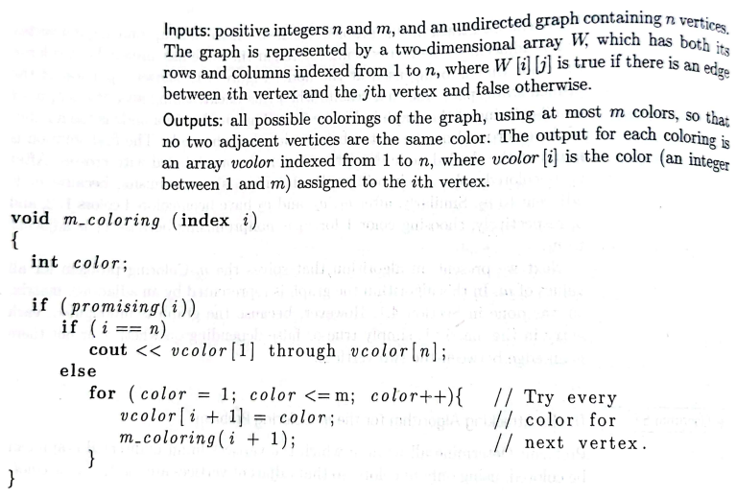
Psudocode
Color(C,j,k,n)
  if j = n+1 then
  output C
  return or quit
  for i = 1 to k
    C[j] = I
    if valid(C,j,n) then
        Color(C,j+1,k,n)
Valid(C,j,n)
for all neighbors v of j with v < j
if C[v] = C[j] then
return false
return true

Slide 43
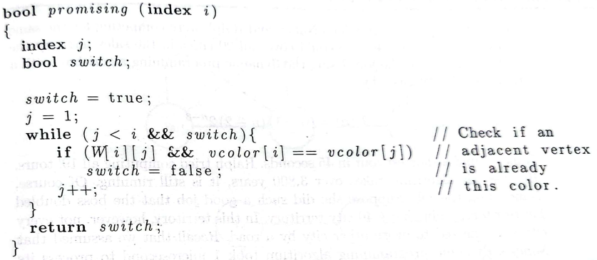


Slide 44
Subset Sum
Given a set X of positive integers and target integer W, is there a subset of elements in X that add up to W?
Notice that there can be more than one such subset.
For example,
if X = {8, 6, 7, 5, 3, 10, 9} and W = 15, the answer is True, because the subsets
{8, 7} and {7, 5, 3} and {6, 9} and {5, 10} all sum to 15. On the other hand, if
X = {11, 6, 5, 1, 7, 13, 12} and W= 15, the answer is False.

Slide 45
Subset Sum
There are two trivial cases. If the target value W is zero, then we can immediately return True, because the empty set is a subset of every set X, and the elements of the empty set add up to zero.6 On the other hand, if W < 0, or if W 6= 0 but the set X is empty, then we can immediately return False.
For the general case, consider an arbitrary element x 2 X. (We’ve already handled the case where X is empty.) There is a subset of X that sums to W if and only if one of the following statements is true:
  There is a subset of X that includes x and whose sum is W.
  There is a subset of X that excludes x and whose sum is W.

Slide 46
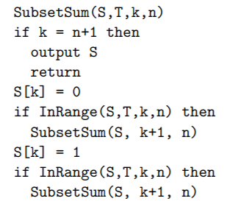
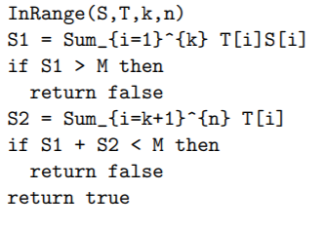
Subset Sum

Slide 47
